Slide 1
Generalization of Randomized Trial Results with Latent Motivation
– A Propensity Score Approach
Chenxiang Li
Andrea Troxel
Division of Biostatistics Department of Population Health
New York University School of Medicine

Slide 2
Internal Validity
Objective: demonstrate causal relationship
Idea: exposed v.s. unexposed
Problem: Exposure related confounders that affect outcome
Gold standard solution: randomization
eliminates systematic association between covariates and treatment assignment
Confounder
---------
Association
Risk Factor
Causal relation of interest
Exposure
Endpoint

Slide 3
Idea of Balancing Scores
When randomization is not possible:
$$f\left(C|Trt\right)=\frac{f\left(C\right)×Pr\left(Trt|C\right)}{\operatorname{Pr}\left(Trt\right)}$$
Where $C$ is a list of confounders, $Trt$ is the treatment arm.
Define $e\left(C\right)=Pr\left(Trt=1|C\right)$. With $\operatorname{Pr}\left(Trt\right)$ being normalization factor:
$$f\left(C|Trt=1\right)×\frac{\operatorname{Pr}\left(Trt=1\right)}{e\left(C\right)}=f\left(C\right)=f\left(C|Trt=0\right)×\frac{\operatorname{Pr}\left(Trt=0\right)}{1−e\left(C\right)}$$
The weighted density of $C$ is now balanced between treatment arms.

Slide 4
External Validity and Result Generalization
Objective: demonstrate causal relationship in target population
Cause: factors affecting participation and outcomes simultaneously.
Solution: random sub-sample
Problem: not usually practical – selection bias
Why? Ethical concerns, practical concerns, accrual status and strategies…
Clinical trials: difficult to generalize
Pragmatic trials: high heterogeneity, wider spectrum thus larger potential bias
Challenge: randomization does not solve selection bias
Omitted Variables
Association
Risk Factor
Derives
Participation
Endpoint

Slide 5
Application of Balancing Score
For a RCT nested in a well-measured cohort:
$$f\left(C|P\right)=\frac{f\left(C\right)×Pr\left(P|C\right)}{\operatorname{Pr}\left(P\right)}$$
$C$ is a list of factors affecting participation, $P$ is participation indicator.
Define $e\left(C\right)=Pr\left(P=1|C\right)$
$$f\left(C|P=1\right)×\frac{\operatorname{Pr}\left(P=1\right)}{e\left(C\right)}=f\left(C\right)=f\left(C|P=0\right)×\frac{\operatorname{Pr}\left(P=0\right)}{1−e\left(C\right)}$$
The weighted density (before normalization) $f\left(C|P=1\right)×\frac{1−e\left(C\right)}{e\left(C\right)}=f\left(C|P=0\right)$

Slide 6
Limitation of Current Methods
What we achieved in the previous slide:
$$f\left(C|P=1\right)×\frac{1−e\left(C\right)}{e\left(C\right)}=f\left(C|P=0\right)$$
It does not ensure balance of factors other than $C$
Assumption: no unobserved critical factors; unconfoundedness.
Outcome is conditionally independent of participation status given $C$
$$E\left[Y^{(1)}−Y^{\left(0\right)}\right]=E_{C}\left\{E\left[Y^{(1)}−Y^{\left(0\right)}|C\right]\right\}=E_{C}\left\{E\left[Y^{(1)}−Y^{\left(0\right)}|P,C\right]\right\}$$
It is useful only when source of selection bias is clearly defined
O’Muircheartaigh et al. Generalizing from unrepresentative experiments: a stratified propensity score approach. Journal of the Royal Statistical Society: Series C (Applied Statistics), 63(2):195–210, 2014.

Slide 7
Limitation of Current Methods
The overly aggressive assumption:
No omitted bias: $C$ are all identified and collected
ALL covariates affecting participation and endpoint
Usually not possible to verify
Those not associated with endpoints are unnecessary.

Slide 8
Inspiration from the Motivating Example
Asch et al. showed financial incentives improved participants’ motivation thus treatment compliance then clinical endpoints. What if…
“Motivation” also affects participation probability?
Trial centers utilize different incentive strategies?
PI decides to change incentive strategy at behind-schedule interim analysis?
What if new treatment and insurance policies published during trial conduct?
……
Even when all known covariates are collected: quantify the abstract concept of motivation.
Motivation
Association
Risk Factor
Derives
Participation
Endpoint
Asch, David A., et al. "Effect of financial incentives to physicians, patients, or both on lipid levels: a randomized clinical trial." Jama 314.18 (2015): 1926-1935.

Slide 9
Applications of Balancing Score
One solution: use latent variable “motivation” as a summary.
Balanced after randomization
Inverse probability weighting (IPW)
Over-sample minorities, adjust for non-response
In clinical trials, “enrichment design”
Weight each individual to form a representative pseudo-population
Sub-classification
Developed by Cochran to adjust for covariates
Calculate for each sub-class and summarize across
Model based adjustments
Daniel Westreich et al. Transportability of trial results using inverse odds of sampling weights. American Journal of Epidemiology, 186(8):1010-1014. 2017. Cochran, W. G. (1968). The Effectiveness of Adjustment by Subclassification in Removing Bias in Observational Studies. Biometrics Vol. 24, No. 2 (Jun., 1968), pp. 295-313.

Slide 10
Notations
Motivation (M, unobserved). Both discrete and continuous.
Participation (P, observed) ~ Ber(π_{p}), $g\left(π_{p}\right)=α_{0}+α_{1}M$
Outcome (Y, observed only for participants) ~ $N\left(μ_{M},σ_{Y}^{2}\right)$,
$$μ_{M}=δ_{0}+δ_{1}Trt+δ_{2}M+δ_{3}Trt×M$$

Slide 11
Multinomial Motivation Setting
Motivation (M, unobserved) ~ Multinomial $(n=1, π={\left(π_{1},π_{2},…,π_{K}\right)}^{T})$, s.t. $\sum_{k=1}^{K}{π_{k}=1 and π_{k}>0, ∀k}$; k=1,2,3,…,K.
k also corresponds to one of the K latent clusters of Y.
$$f\left(Y;γ,π,σ_{Y}\right)=\sum_{k=1}^{K}{π_{k}N[Y;γ_{k},σ_{Y}]}$$
$γ_{k}=(γ_{0k},γ_{1k})$; Semi-parametric model: no between cluster relationship specified.

Slide 12
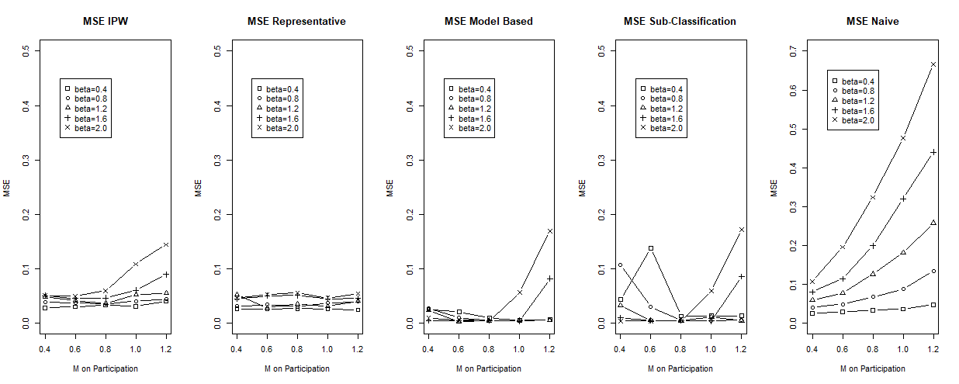
Results – Multinomial Motivation
Simulation with 3 clusters. Performance comparisons:
IPW is robust and comparable to a representative sample.
Model-based is vulnerable to model mis-specification.
Sub-classification is unstable when clusters are not well-separated.

Slide 13
Continuous Motivation Setting

Slide 14
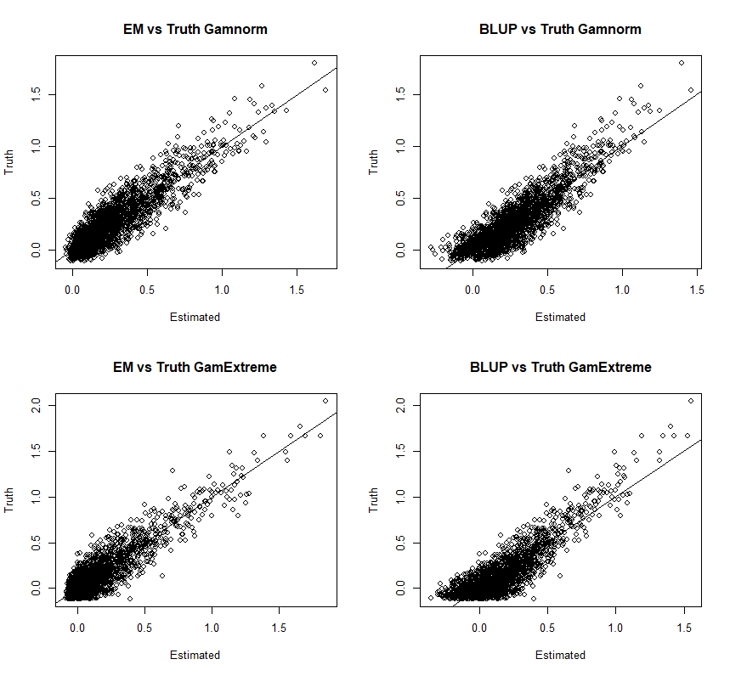
Results – Continuous Motivation Estimation
Two Gamma distributions: GamNorm (2, 5) and GamExtreme (0.5, 2.5)
EM based estimations are superior
BLUP lacks the knowledge of bounded distribution.
Mixed effect models are preferable due to ease of interpretation and less computational cost.
Thaddeus Tarpey and Eva Petkova. Latent Regression Analysis. Stat Modelling. 2010 July 1; 10(2): 133–158.

Slide 15
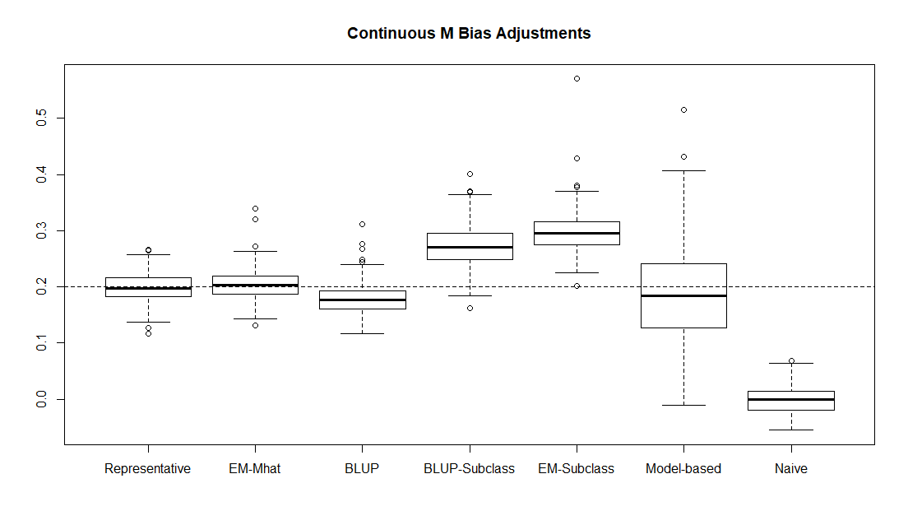
Results – Continuous Motivation
Representative EM-IPW BLUP-IPW BLUP-Subclass EM-Subclass Model-based Naïve
Project results from the Gamma Extreme to Gamma Norm.
EM-based weights had less bias, comparable to representative results
Model-based and sub-classification were not satisfactory

Slide 16
Idea of Balancing Scores
Recommended Procedures
When treatment heterogeneity is suspected:
Finite Mixture Model
Yes
Bootstrap with Multinomial
Stable?
No
Mixed Effect Model
BLUP Normal?
No
Yes
Continuous Latent Variable Model
Mixed Effect Model
Notes:
But how do we know that there exist treatment heterogeneity in the first place???

Slide 17
Thank You!

